Slide 1

Phishing Attacks
Made BY- GArV JAIN

Slide 2

CONTENTS
INTRODUCTION
WHAT IS PHISHING
HOW DOES PHISHING WORKS
EXAMPLES
HOW TO PROTECT YOURSELF
CAUSES

Slide 3

INTRODUCTION
Phishing is the most powerful and popular attack for hacking into e-mails and web accounts.
Cyber criminals use this attack to hack into bank accounts , Facebook accounts and e-mail accounts of innocent people.
Most of the biggest cyber crime cases involve phishing techniques.

Slide 4

WHAT IS PHISHING?
Phishing is the act of fooling a computer user into submitting personal information by creating a counterfeit website that looks like a real/true website.
It’s a hacker technique of “fishing” for passwords and other secret financial info.

Slide 5
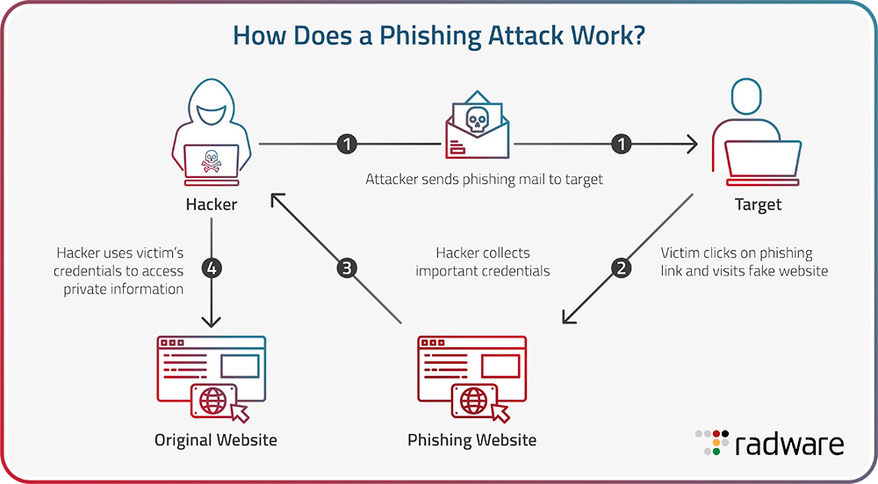
HOW DOES PHISHING WORK ?

Slide 6
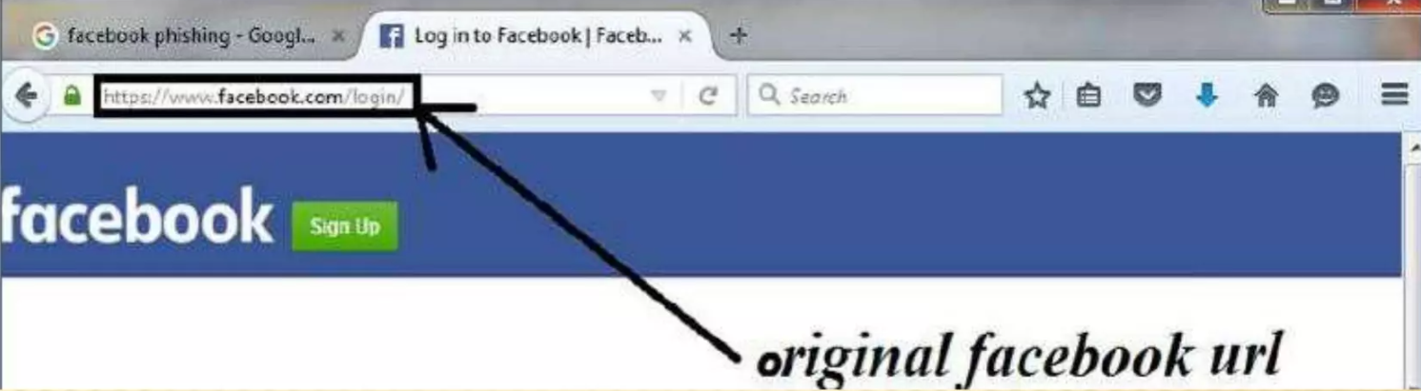
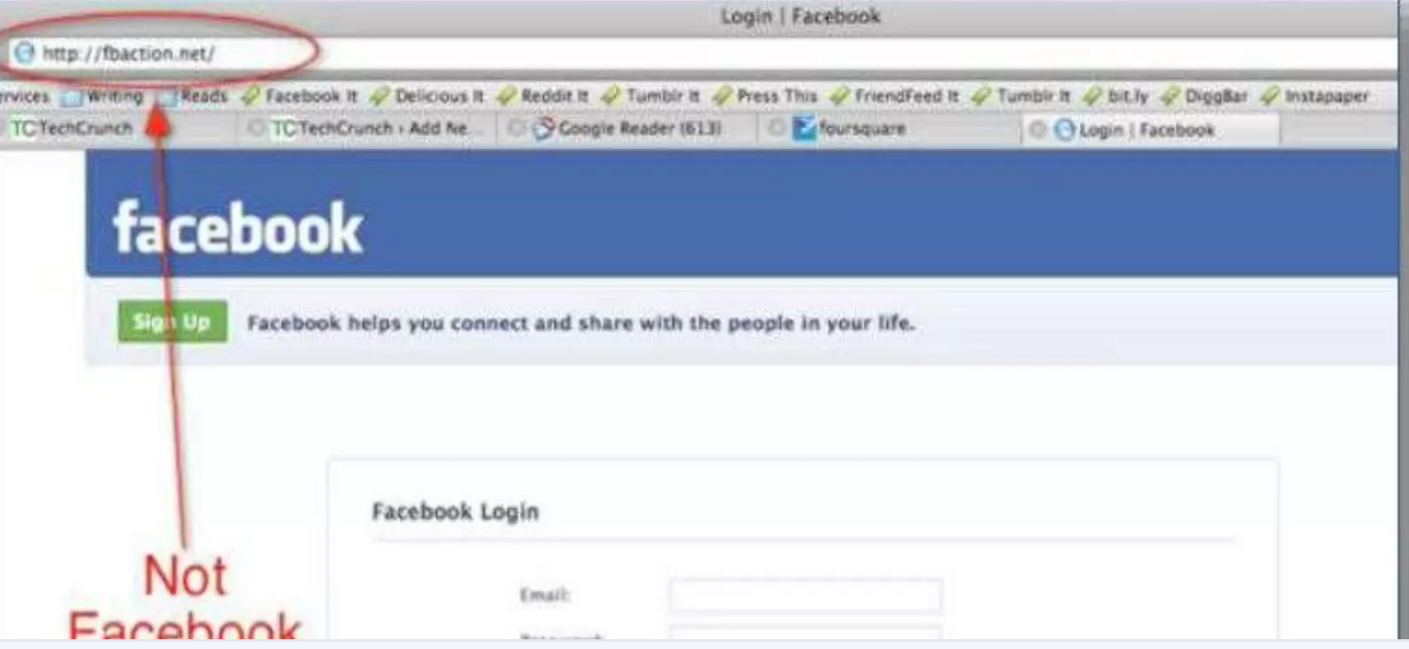
PHISHING EXAMPLES

Slide 7
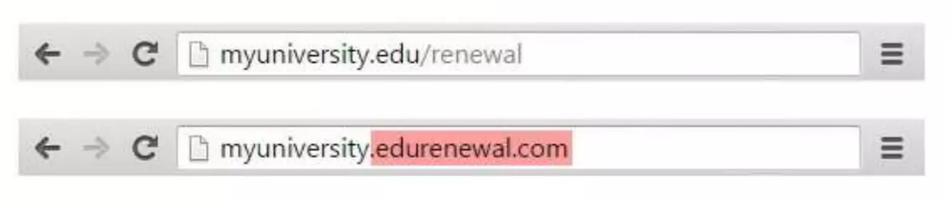
PHISHING EXAMPLE

Slide 8

How do I protect against phishing attacks
1) USER EDUCATION
One way to protect your organization from phishing is user education.
Education should involve all employees.
High-level executives are often a target Teach them how to recognize a phishing email and what to do when they receive one.
Simulation exercises are also key for assessing how your employees react to a staged phishing attack.

Slide 9

2) SECURITY TECHNOLOGY
No single cyber security technology can prevent phishing attacks .
Instead, organizations must take a layered approach to reduce the number of attacks and lessen their impact when they do occur.
Network security technologies that should be implemented include email and web security , malware protection , user behaviour monitoring and access control.

Slide 10

CAUSES OF PHISHING
Misleading e-mails
No check of source address
Vulnerability in browsers
No strong authentication at websites of banks and financial institutions • Limited use of digital signatures
Non-availability of secure desktop tools
Lack of user awareness
Vulnerability in applications

Slide 11


